Slide 1
Agenda
Day 3 | Instance Based Learning: Introduction, K-nearest neighbor learning, locally weighted regression, radial basis function, cased based reasoning. Reinforced Learning: Introduction, Learning Task, Q Learning
https://github.com/profthyagu
http://proftgs.blogspot.com
Gmail1: profthyagu@gmail.com
Gmail2 : innovationscontext@gmail.com
Mobile : 9480123526

Slide 2
1.1 Instance Based Learning
Memory-based learning (also called instance-based learning) is a type of learning algorithm that compares new test data with training data in order to solve the given machine learning problem.
Such algorithms search for the training data that are most similar to the test data and make predictions based on these similarities.
Learning in these algorithms consists of simply storing the presented training data. When a new query instance is encountered a set of similar related instances is retrieved from memory and used to classify the new query instance.
Examples : k-nearest neighbor learning , locally weighted regression, Radial Basis function (RBF), kernel machines and Case based Reasoning .

Slide 3
Key idea of Instance based learning
Key idea: instance-based learning constructs the target function only when a new instance must be classified.
Only store all training examples where x describes the attributes of each instance and f(x) denotes its class (or value).
Use a Nearest Neighbor method:
Given query instance ,
first locate nearest (most similar) training example ,
then estimate

Slide 4
K Nearest Neighbor Learning
The nearest neighbours of an instance are defined in terms of the standard Euclidean Distance d(x_{i}, x_{j}) .
Let an arbitrary instance x be described by the feature vector (set of attributes) as follows:
where ar(x) denotes the value of the r^{th} attribute of instance x. Then the distance between two instances xi and xj is defined to be d(x_{i}, x_{j}) where

Slide 5
K Nearest Neighbor Algorithm
Training Algorithm
For each training example <x , f(x) >, add the example to the list of training_examples
Classification Algorithm
Given a query instance xq to be classified
Let x₁ … x_{k} denote the k instances from training_examples that are nearest to x_{q}
Return

Slide 6
k-Nearest Neighbor:
Given query instance , take vote among its k nearest neighbors to decide its class, (return most common value of f among the k nearest training elements to )
1-NN, class is , 5-NN, class is
Advantage: overcome class noise in training set.

Slide 7

Example

Slide 8
Continuous vs Discrete valued functions (classes)
K-NN works well for discrete-valued target functions. Furthermore, the idea can be extended for continuos (real) valued functions. In this case we can take mean of the f values of k nearest neighbors:

Slide 9
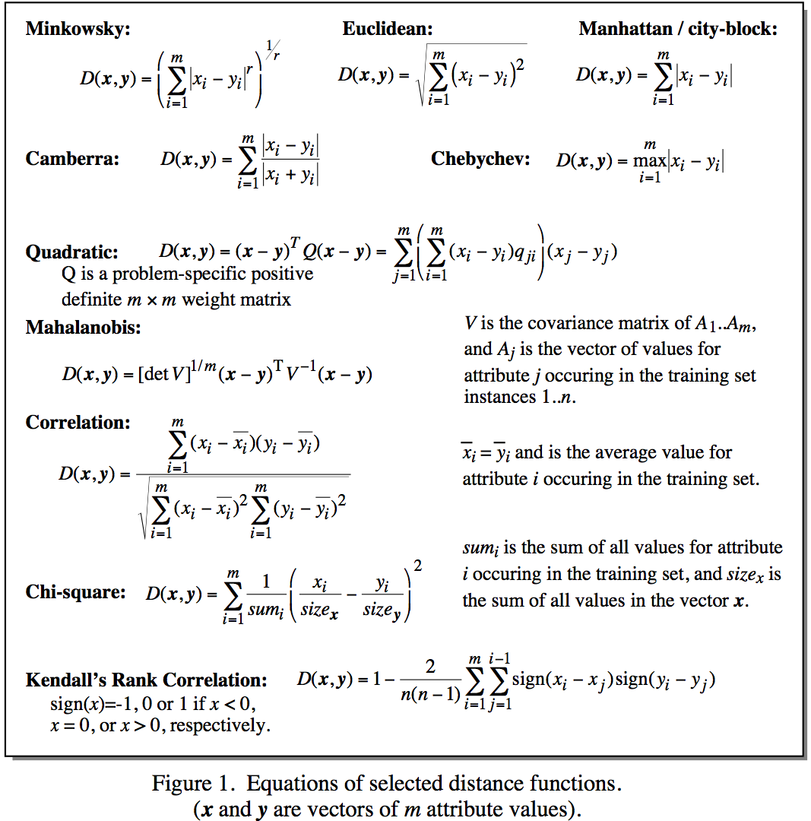
Distance Metrics
Notes:
Minkowsky = l-norm

Slide 10
When To Consider Nearest Neighbor ?
Instances map to points in
Average number of attributes (e.g. Less than 20 attributes per instance)
Lots of training data
When target function is complex but can be approximated by separate local simple approximations

Slide 11
Lab Program9
Write a program to implement k-Nearest Neighbour algorithm to classify the iris data set. Print both correct and wrong predictions. Python ML library classes can be used for this problem.

Slide 12
Source Code

Slide 13
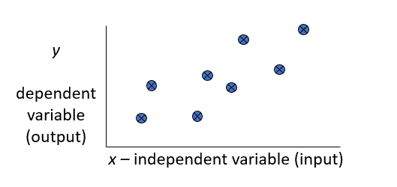
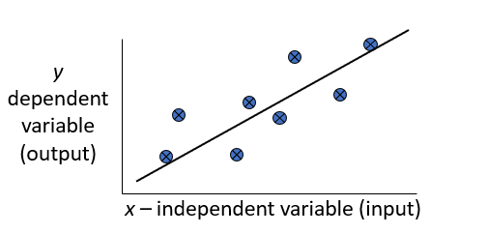
Regression
Regression is a technique from statistics that is used to predict values of a desired target quantity when the target quantity is continuous .
In regression, we seek to identify (or estimate) a continuous variable y associated with a given input vector x.
y is called the dependent variable.
x is called the independent variable.

Slide 14
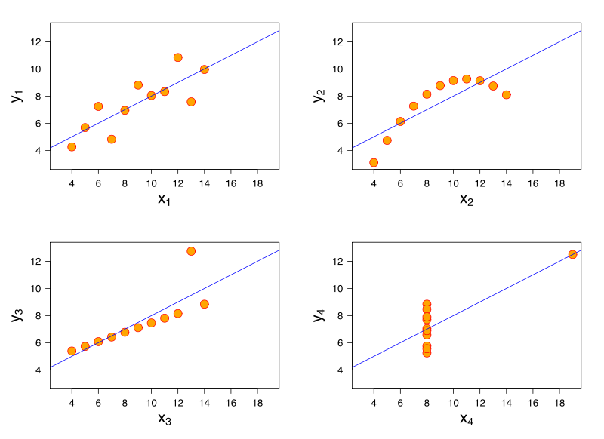
What lines "really" best fit each case?

Slide 15
1.2 Locally-weighted Regression
Basic idea: Locally weighted regression constructs an explicit approximation to f over a local region surrounding xq.
LWR uses nearby or distance weighted training examples to form this local approximation to f.
The target function is approximated using linear function , quadratic or a multilayer neural network or some other functional form.

Slide 16
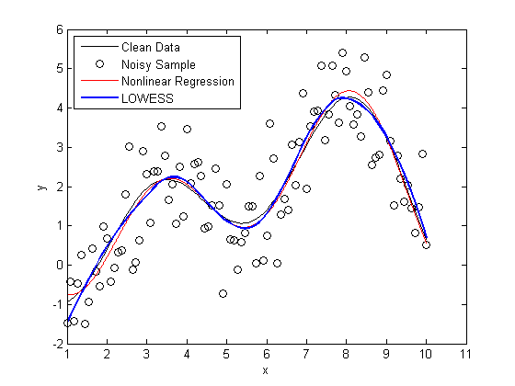
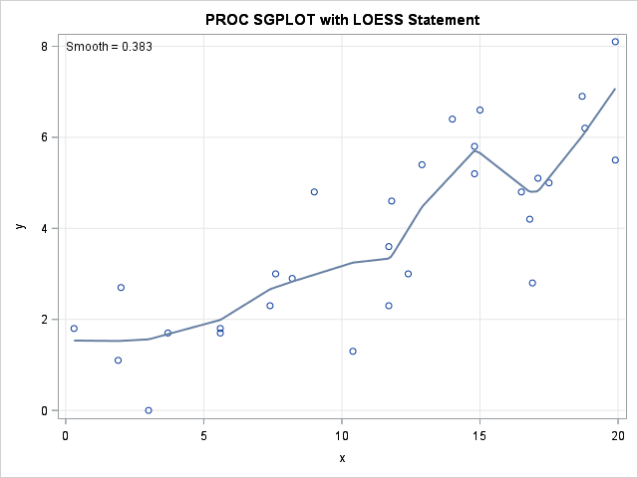
Loess/Lowess Regression
Loess regression is a nonparametric technique that uses local weighted regression to fit a smooth curve through points in a scatter plot.

Slide 17

Lowess Algorithm
Locally weighted regression is a very powerful non-parametric model used in statistical learning .Given a dataset X, y, we attempt to find a model parameter β(x) that minimizes residual sum of weighted squared errors. The weights are given by a kernel function(k or w) which can be chosen arbitrarily .
Algorithm
Read the Given data Sample to X and the curve (linear or non linear) to Y
Set the value for Smoothening parameter or Free parameter say τ
Set the bias /Point of interest set X0 which is a subset of X
Determine the weight matrix using Tricube weight function
w = (1 - w ** 3) ** 3 # Tricube Weight Function
Determine the value of model term parameter β using :
Prediction = x0*β

Slide 18
Lab Program 10
Implement the non-parametric Locally Weighted Regression (LOWESS) algorithm in order to fit data points. Select appropriate data set for your experiment and draw graphs.

Slide 19
Source Code

Slide 20

1.3 Radial basis Function Networks
One approach to function approximation that is closely related to distance weighted regression and also to artificial neural network is learning with radial basis functions .
Global approximation to target function in terms of linear combination of local approximations
Used e.g. for image classification
In this approach the learned hypothesis is a function of the form

Slide 21
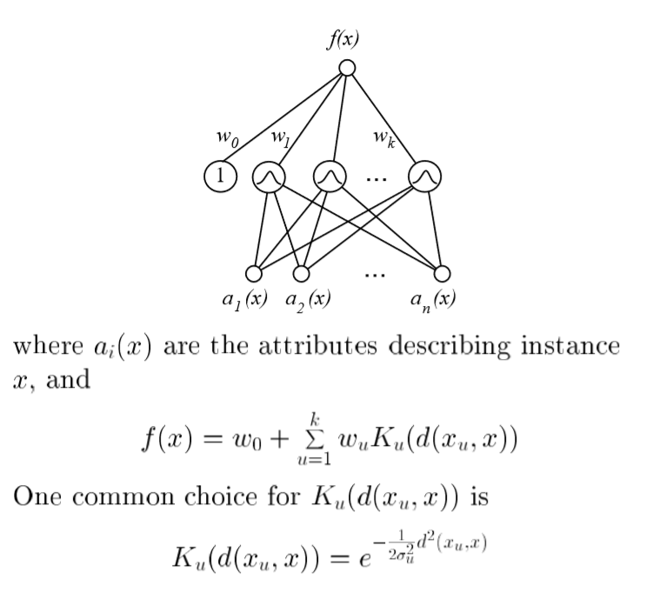

Slide 22

Training of RBF network
Given a set of training examples of the target function, RBF networks are typically trained in a two-stage process.
First, the number k of hidden units is determined and each hidden unit u is defined by choosing the values of xu and σu^2: that define its kernel function Ku(d(xu, x)).
Second, the weights w, are trained to maximize the fit of the network to the training data, using the global error criterion given by Equation
Because the kernel functions are held fixed during this second stage, the linear weight values w, can be trained very efficiently.

Slide 23
1.4 Case Based Reasoning
In CBR, instances are typically represented using symbolic descriptions, and the methods used to retrieve similar instances are correspondingly more elaborate.
CBR has been applied to problems such
as conceptual design of mechanical devices based on a stored library of previous designs
reasoning about new legal cases based on previous rulings and
solving planning and scheduling problems by reusing and combining portions of previous solutions to similar problems

Slide 24
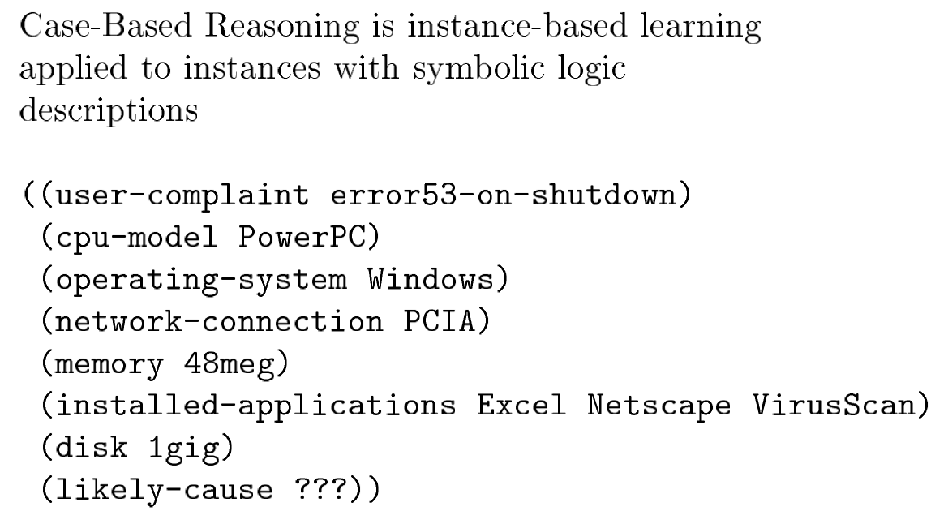
Case Based Reasoning

Slide 25
Case Based Reasoning in CADET
The CADET system (Sycara et al. 1992) employs case- based reasoning to assist in the conceptual design of simple mechanical devices such as water faucets.
It uses a library containing approximately 75 previous designs and design fragments to suggest conceptual designs to meet the specifications of new design problems.
Each instance stored in memory (e.g., a water pipe) is represented by describing both its structure and its qualitative function.
New design problems are then presented by specifying the desired function and requesting the corresponding structure.

Slide 26
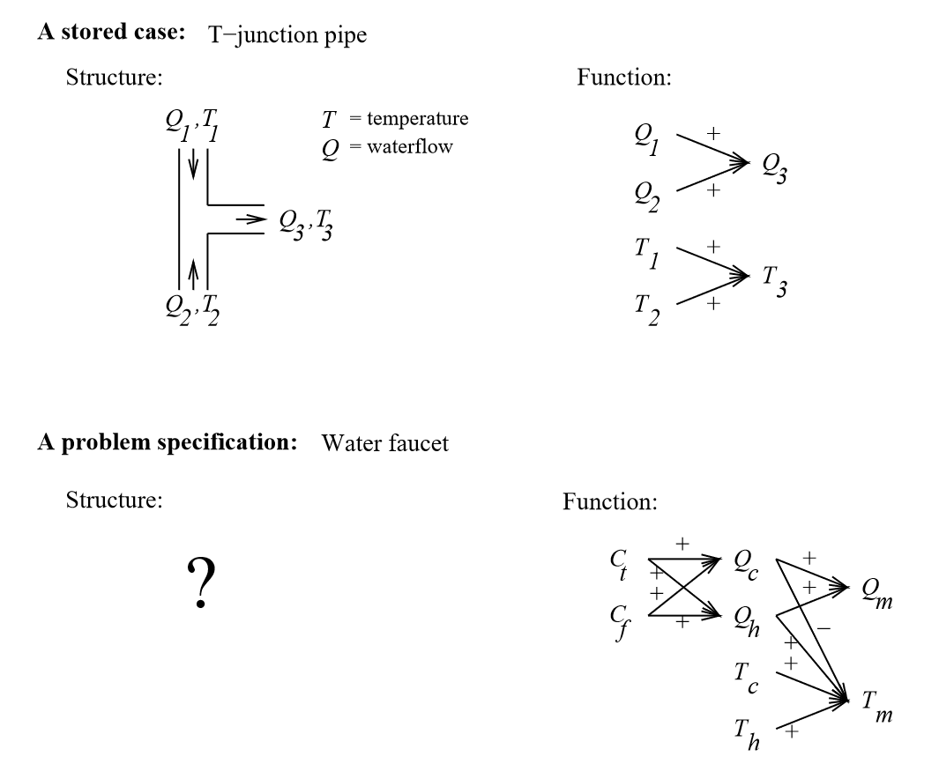
Case Based Reasoning in CADET

Slide 27
Qc, refers to the flow of cold water into the faucet,
Qh to the input flow of hot water, and
Qm, to the single mixed flow out of the faucet.
Similarly, Tc, Th, and Tm , refer to the temperatures of the cold water, hot water, and mixed water respectively.
The variable Ct, denotes the control signal for temperature that is input to the faucet, and
Cf denotes the control signal for waterflow.

Slide 28
2. Reinforced Learning
Reinforcement learning addresses the question of how an autonomous agent that senses and acts in its environment can learn to choose optimal actions to achieve its goals.
This very generic problem covers tasks such as learning to control a mobile robot, learning to optimize operations in factories, and learning to play board games. Each time the agent performs an action in its environment, a trainer may provide a reward or penalty to indicate the desirability of the resulting state.
For example, when training an agent to play a game the trainer might provide a positive reward when the game is won, negative reward when it is lost, and zero reward in all other states. The task of the agent is to learn from this indirect, delayed reward, to choose sequences of actions that produce the greatest cumulative reward.

Slide 29
Building a Learning Robot
Consider building a learning robot. The robot, or agent, has a set of sensors to observe the state of its environment, and a set of actions it can perform to alter this state.
For example, a mobile robot may have sensors such as a camera and sonars, and actions such as "move forward" and "turn.“
Its task is to learn a control strategy, or policy, for choosing actions that achieve its goals.
For example, the robot may have a goal of docking onto its battery charger whenever its battery level is low.

Slide 30
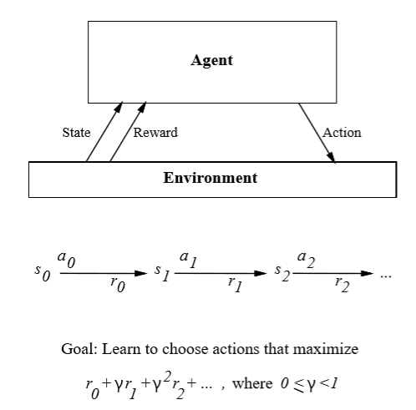
2.Reinforcement Learning

Slide 31
Explanation
An agent interacting with its environment. The agent exists in an environment described by some set of possible states S.
It can perform any of a set of possible actions A. Each time it performs an action a, in some state st the agent receives a real-valued reward r, that indicates the immediate value of this state-action transition. This produces a sequence of states si, actions ai, and immediate rewards ri as shown in the figure.
The agent's task is to learn a control policy, π : S -> A, that maximizes the expected sum of these rewards, with future rewards discounted exponentially by their delay

Slide 32
The aspects which makes RL different from other
The reinforcement learning problem differs from other function approximation tasks in several important respects
Delayed reward: Determining which of the actions in its sequence are to be credited with producing the eventual rewards
Exploration : The learner faces a tradeoff in choosing whether to favor exploration of unknown states and actions (to gather new information), or exploitation of states and actions that it has already learned will yield high reward (to maximize its cumulative reward).
Partially observable states: in many practical situations sensors provide only partial information.
Life-long learning

Slide 33
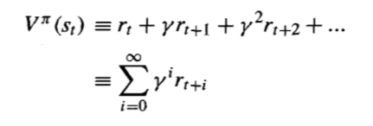
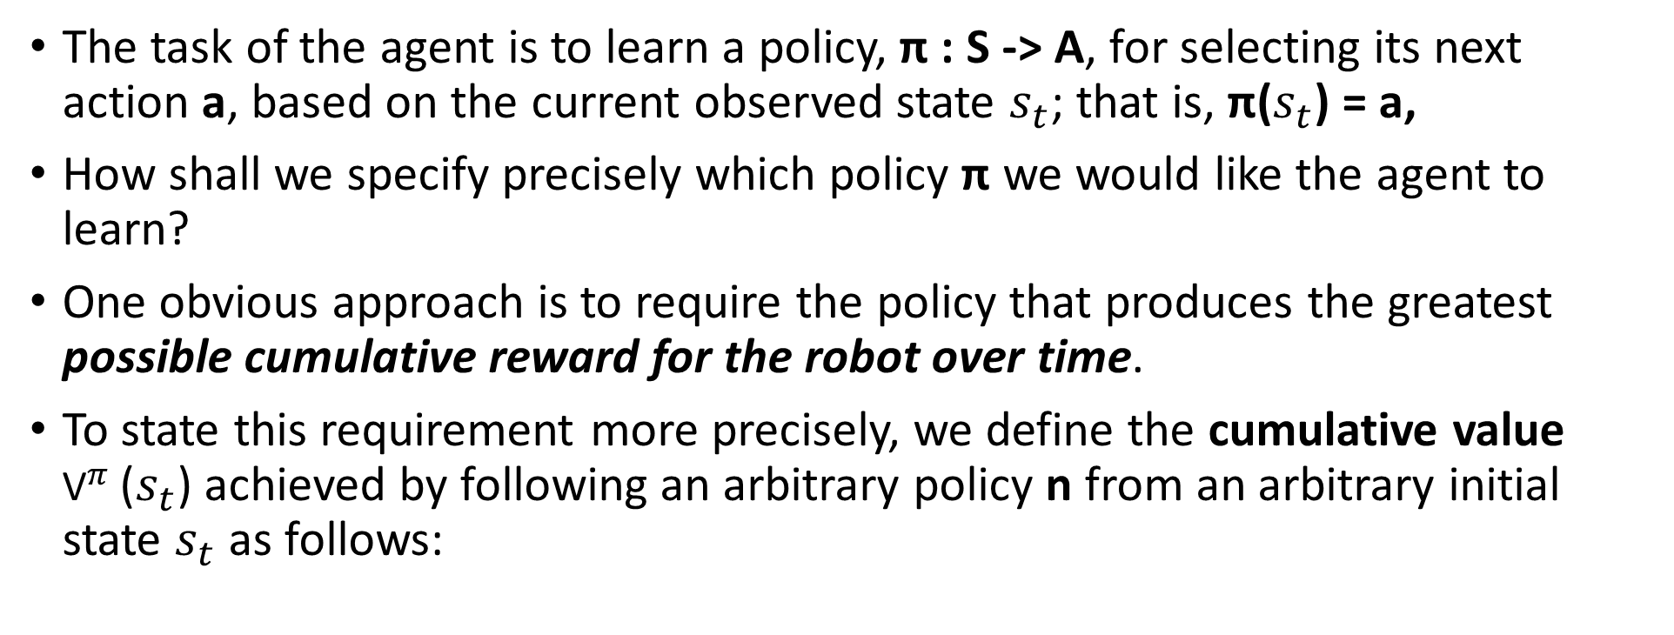
Agents Learning Task (Value Function)
The task of the agent is to learn a policy, π : S -> A, for selecting its next action a, based on the current observed state $s_{t}$; that is, π($s_{t}$) = a,
How shall we specify precisely which policy π we would like the agent to learn?
One obvious approach is to require the policy that produces the greatest possible cumulative reward for the robot over time.
To state this requirement more precisely, we define the cumulative value ${\text{V}}^{π}$($s_{t}$) achieved by following an arbitrary policy n from an arbitrary initial state $s_{t}$ as follows:

Slide 34
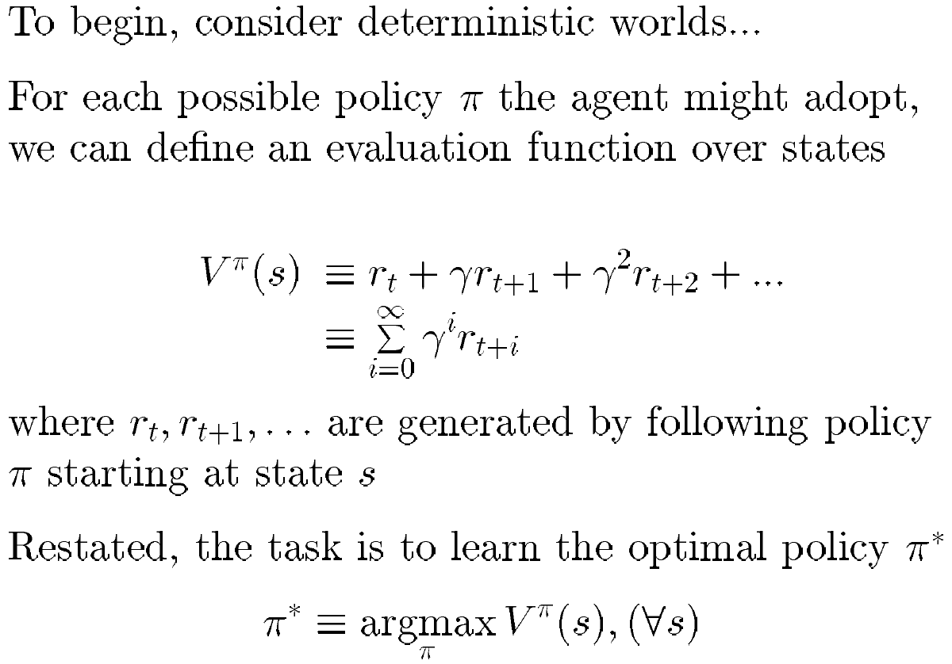
Value Function
The quantity ${\text{V}}^{π}$($s_{t}$) is often called the discounted cumulative reward achieved by policy π.

Slide 35
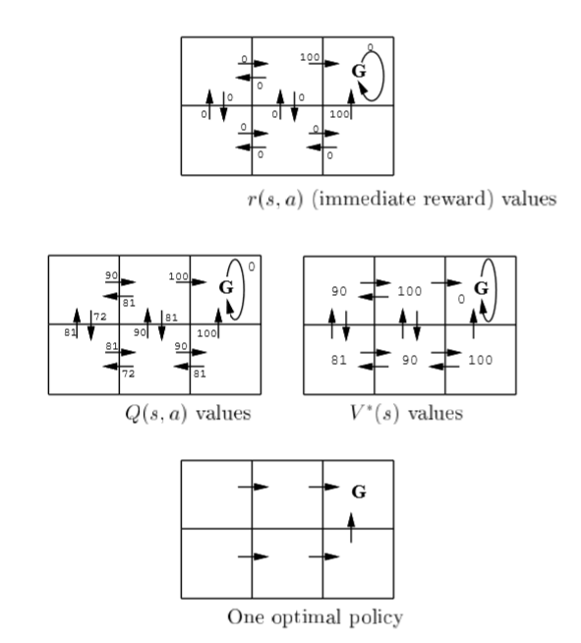
The six grid squares in this diagram represent six possible states, or locations, for the agent.
Each arrow in the diagram represents a possible action the agent can take to move from one state to another.
The number associated with each arrow represents the immediate reward r(s,a) the agent receives if it executes the corresponding state-action transition.
Note the immediate reward in this particular environment is defined to be zero for all state-action transitions except for those leading into the state labeled G.
It is convenient to think of the state G as the goal state, because the only way the agent can receive reward, in this case, is by entering this state.
Note in this particular environment, the only action available to the agent once it enters the state G is to remain in this state.
For this reason, we call G an absorbing state.

Slide 36
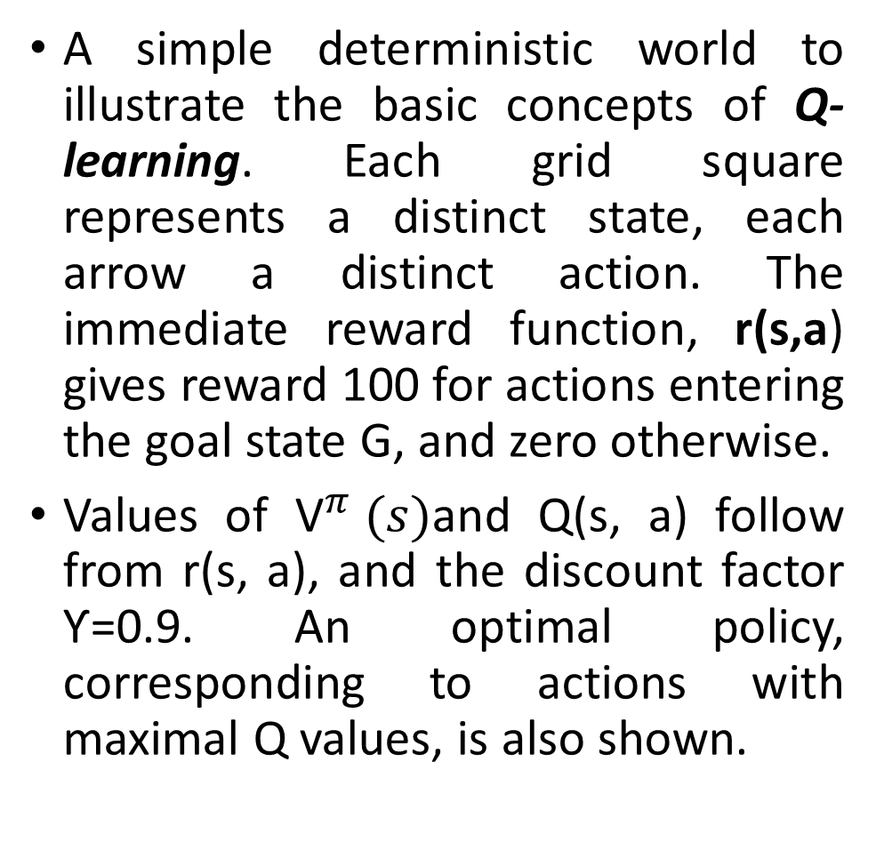
A simple deterministic world to illustrate the basic concepts of Q-learning. Each grid square represents a distinct state, each arrow a distinct action. The immediate reward function, r(s,a) gives reward 100 for actions entering the goal state G, and zero otherwise.
Values of ${\text{V}}^{π} (s)$and Q(s, a) follow from r(s, a), and the discount factor Ƴ=0.9. An optimal policy, corresponding to actions with maximal Q values, is also shown.

Slide 37
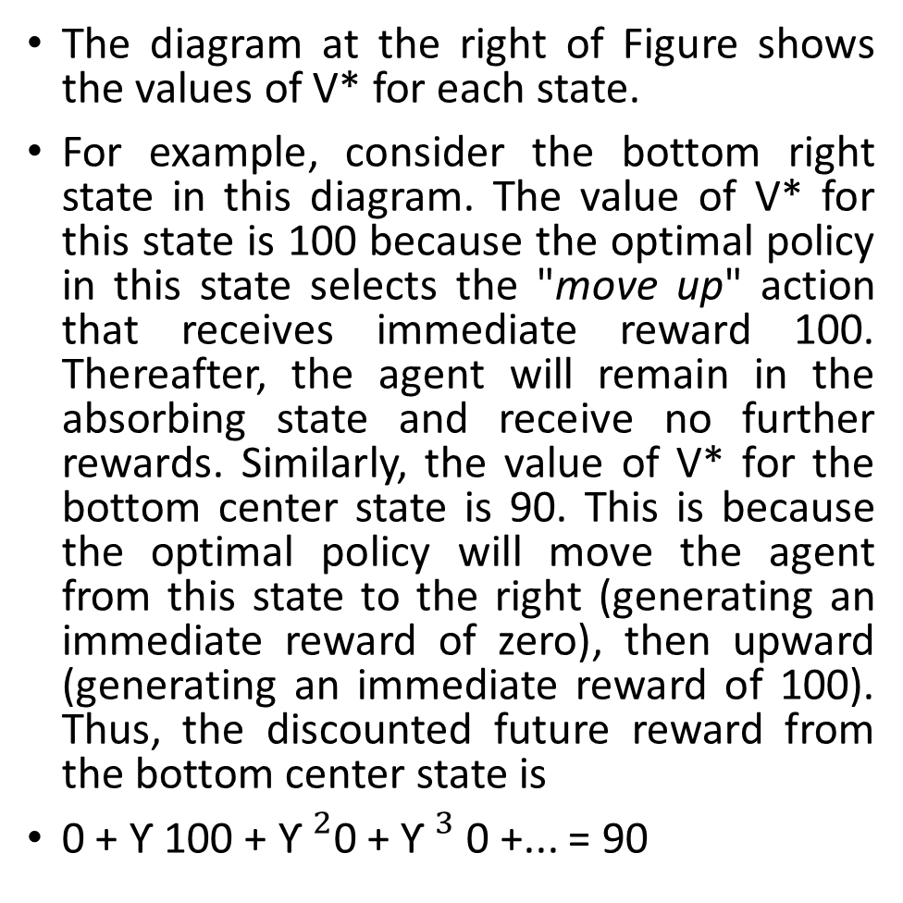
The diagram at the right of Figure shows the values of V* for each state.
For example, consider the bottom right state in this diagram. The value of V* for this state is 100 because the optimal policy in this state selects the "move up" action that receives immediate reward 100. Thereafter, the agent will remain in the absorbing state and receive no further rewards. Similarly, the value of V* for the bottom center state is 90. This is because the optimal policy will move the agent from this state to the right (generating an immediate reward of zero), then upward (generating an immediate reward of 100). Thus, the discounted future reward from the bottom center state is
0 + Ƴ 100 + ${\text{Ƴ}}^{2}$0 + ${\text{Ƴ}}^{3}$0 +... = 90

Slide 38
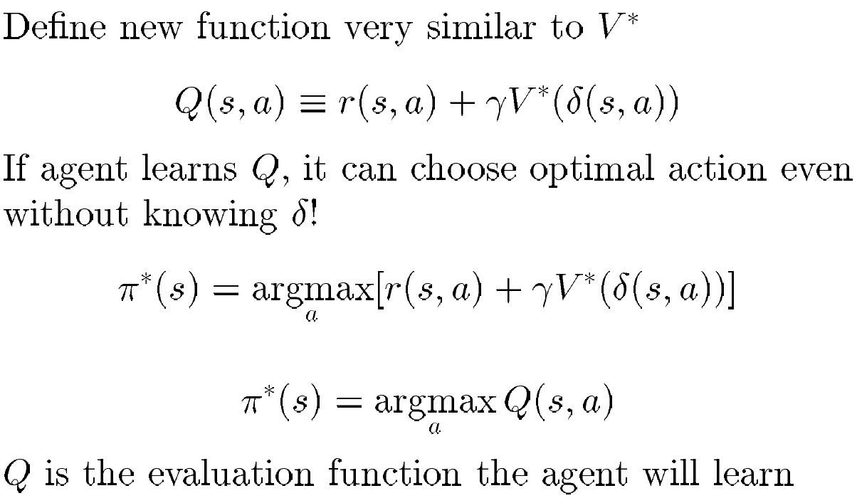
Q Function

Slide 39
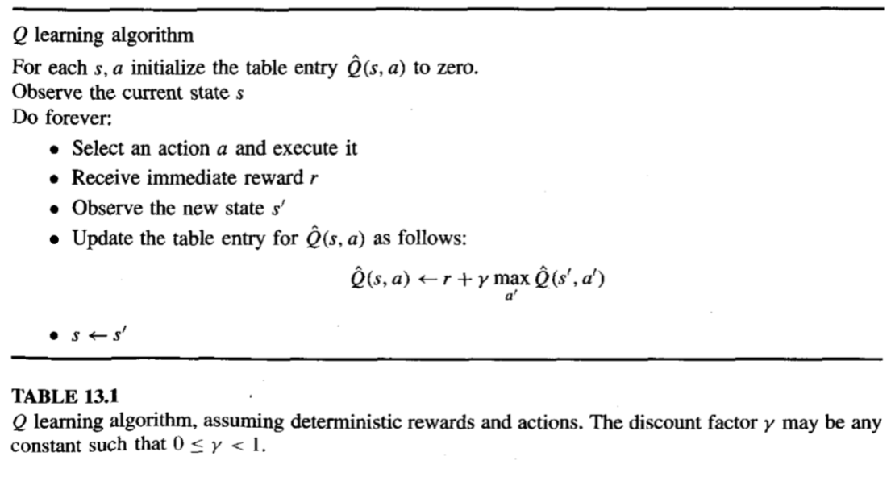
An Algorithm for Learning Q

Slide 40
End

